Slide 1


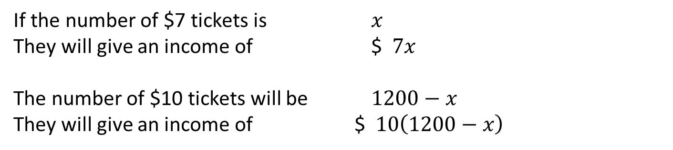



Example 1
Remember this Example?
A drama group hire a theatre for their play. They expect to sell all 1200 tickets at a price of either $10 or $7. They need to cover their $4150 production costs, donate $4000 to charity and make a profit of $1000.
If they want to make enough money exactly, how many of the total 1200 tickets should they charge at $10 and how many at $7?
The total number of $7 and $10 tickets will be 1200.
They need to make $9150 in total.
$$7x+10\left(1200−x\right)=9150$$
If the number of $7 tickets is $x$
They will give an income of $ $7x$
The number of $10 tickets will be $1200−x$
They will give an income of $ $10\left(1200−x\right)$
$$7x+12000−10x=9150$$
$$12000−3x=9150$$
-12000
-12000
$$−3x=−2850$$
/-3
/-3
The group should sell 950 tickets at $7 each and the remaining 250 tickets at $10 each.
$$x=950$$
To solve this we used only one variable

Slide 2

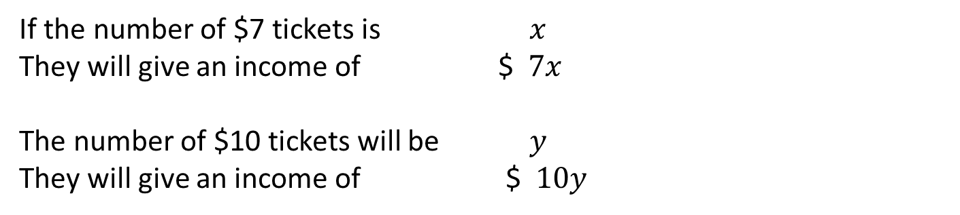

Example 1
We could instead introduce two variables
A drama group hire a theatre for their play. They expect to sell all 1200 tickets at a price of either $10 or $7. They need to cover their $4150 production costs, donate $4000 to charity and make a profit of $1000.
If they want to make enough money exactly, how many of the total 1200 tickets should they charge at $10 and how many at $7?
The total number of $7 and $10 tickets will be 1200.
They need to make $9150 in total.
$$x+y=1200$$
If the number of $7 tickets is $x$
They will give an income of $ $7x$
The number of $10 tickets will be $y$
They will give an income of $ $10y$
$$7x+10y=9150$$
These are called ‘simultaneous equations’ and can be solved to calculate the two variables.

Slide 3


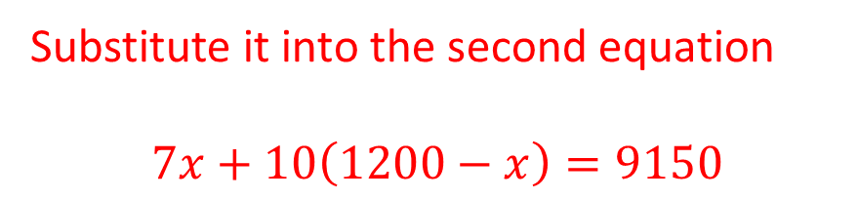
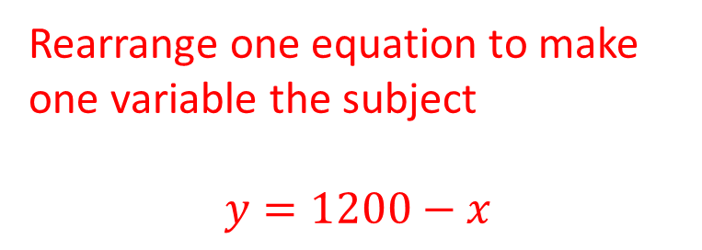

Example 1
Substitute in an equation
A drama group hire a theatre for their play. They expect to sell all 1200 tickets at a price of either $10 or $7. They need to cover their $4150 production costs, donate $4000 to charity and make a profit of $1000.
If they want to make enough money exactly, how many of the total 1200 tickets should they charge at $10 and how many at $7?
The total number of $7 and $10 tickets will be 1200.
They need to make $9150 in total.
$$Method 1−Substitution$$
Rearrange one equation to make one variable the subject
$$y=1200−x$$
$$x+y=1200$$
$$7x+10y=9150$$
Substitute it into the second equation
$$7x+10\left(1200−x\right)=9150$$
Therefore they should sell 950 tickets at $7 and 250 at $10.
$$7x+12000−10x=9150$$
$$−3x=−2850$$
$$x=950$$

Slide 4
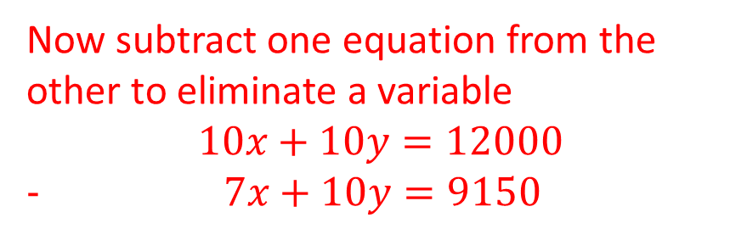
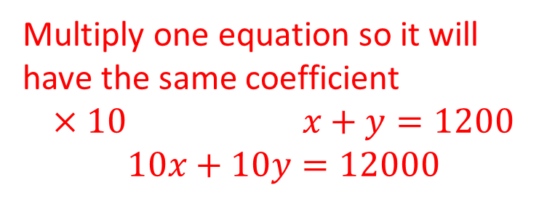

Example 1
Eliminate a variable
A drama group hire a theatre for their play. They expect to sell all 1200 tickets at a price of either $10 or $7. They need to cover their $4150 production costs, donate $4000 to charity and make a profit of $1000.
If they want to make enough money exactly, how many of the total 1200 tickets should they charge at $10 and how many at $7?
The total number of $7 and $10 tickets will be 1200.
They need to make $9150 in total.
$$Method 2−Elimination$$
Multiply one equation so it will have the same coefficient
$$×10 x+y=1200$$
$$10x+10y=12000$$
$$x+y=1200$$
$$7x+10y=9150$$
Now subtract one equation from the other to eliminate a variable
$$10x+10y=12000$$
$7x+10y=9150$
Therefore they should sell 950 tickets at $7 and 250 at $10.
$$3x=2850$$
$$x=950$$

Slide 5
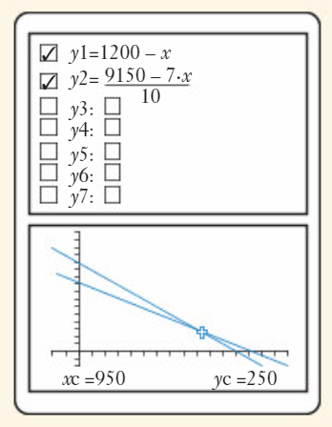
Example 1
Eliminate a variable
A drama group hire a theatre for their play. They expect to sell all 1200 tickets at a price of either $10 or $7. They need to cover their $4150 production costs, donate $4000 to charity and make a profit of $1000.
If they want to make enough money exactly, how many of the total 1200 tickets should they charge at $10 and how many at $7?
The total number of $7 and $10 tickets will be 1200.
They need to make $9150 in total.
We can also solve this by using the graphical tool on the classpad. The intersection of the two equations shows the simultaneous solution
$$x+y=1200$$
$$7x+10y=9150$$
Therefore they should sell 950 tickets at $7 and 250 at $10.

Slide 6


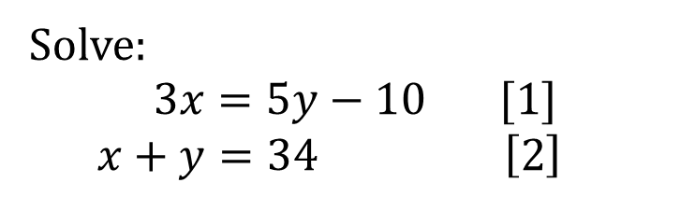


Example 3
Solve:
$$3x=5y−10 [1]$$
$$x+y=34 \left[2\right]$$
From [2] we can create the equation $y=34−x$
Substituting this into [1] we get $3x=5(34−x)−10$
Solving for the equation for x $3x=170−5x−10$
$$3x=160−5x$$
$$8x=160$$
$$x=20$$
And thus $y=14$

Slide 7


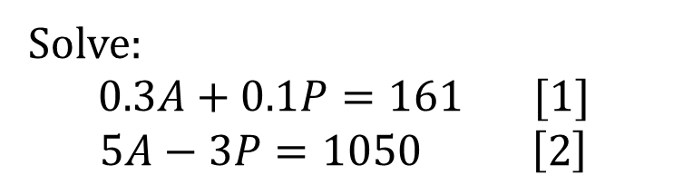


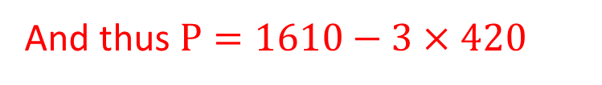
Example 3
Solve:
$$0.3A+0.1P=161 [1]$$
$$5A−3P=1050 \left[2\right]$$
Multiply [1] x10 to avoid decimals $3A+P=1610$
From [1] we can create the equation $P=1610−3A$
Substituting this into [2] we get $5A−3(1610−3A)=1050$
Solving for the equation for A $5A−4830+9A=1050$
$$14A−4830=1050$$
$$14A=5880$$
$$A=420$$
And thus $P=1610−3×420$
$P=350$

Slide 8
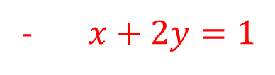
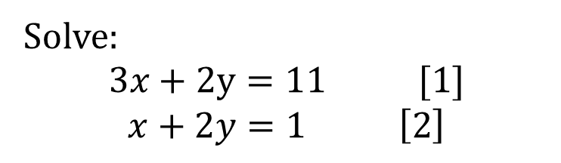

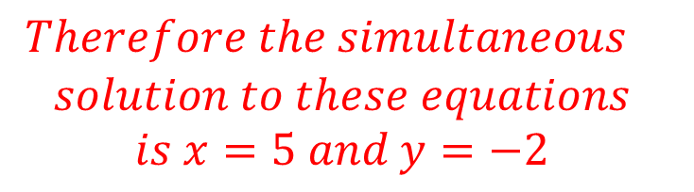




Example 4
Solve:
$$3x+2y=11 [1]$$
$$x+2y=1 \left[2\right]$$
Both equations involve +2y and therefore subtracting one equation from the other will eliminate the variable y
Equation [1] – [2] gives us $3x+2y=11$
- $x+2y=1$
$Therefore the simultaneous$
$$solution to these equations$$
$$is x=5 and y=−2$$
$$2x+0y=10$$
$$2x=10$$
$$x=5$$
Substitute this into either equation to solve y $5+2y=1$
$2y=−4$
$y=−2$

Slide 9
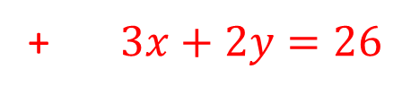

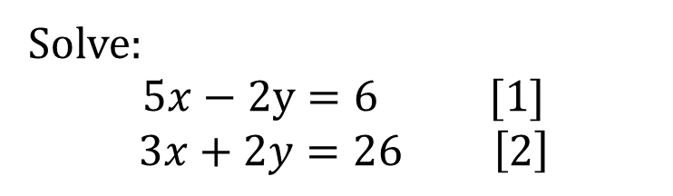

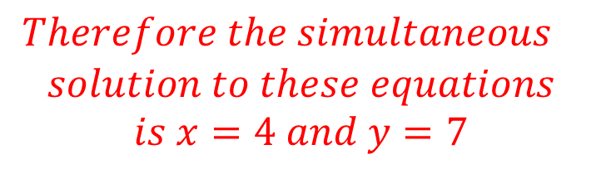




Example 4
Solve:
$$5x−2y=6 [1]$$
$$3x+2y=26 \left[2\right]$$
One equation involves +2y and the other -2y, therefore adding one equation to the other will eliminate the variable y
Equation [1] + [2] gives us $5x−2y=6$
+ $3x+2y=26$
$Therefore the simultaneous$
$$solution to these equations$$
$$is x=4 and y=7$$
$$8x+0y=32$$
$$8x=32$$
$$x=4$$
Substitute this into either equation to solve y $5\left(4\right)−2y=6$
$20−2y=6$
$−2y=−14$
$y=7$

Slide 10
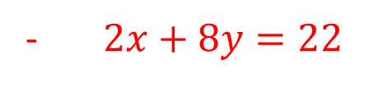
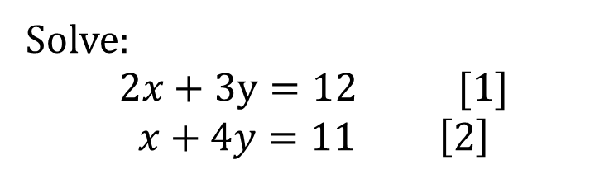



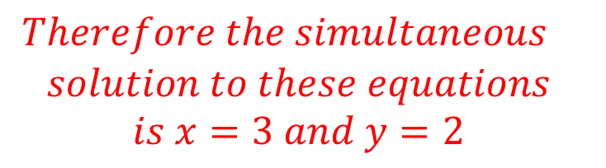


Example 4
Solve:
$$2x+3y=12 [1]$$
$$x+4y=11 \left[2\right]$$
Leaving the first equation unchanged but multiplying the second equation by 2 gives us two equations featuring 2x, which can then be subtracted to eliminate the variable.
Equation [1] – 2x[2] gives us $2x+3y=12$
- $2x+8y=22$
$Therefore the simultaneous$
$$solution to these equations$$
$$is x=3 and y=2$$
$$0x−5y=−10$$
$$−5y=−10$$
$$y=2$$
Substitute this into either equation to solve x $x+4(2)=11$
$x+8=11$
$x=3$

Slide 11
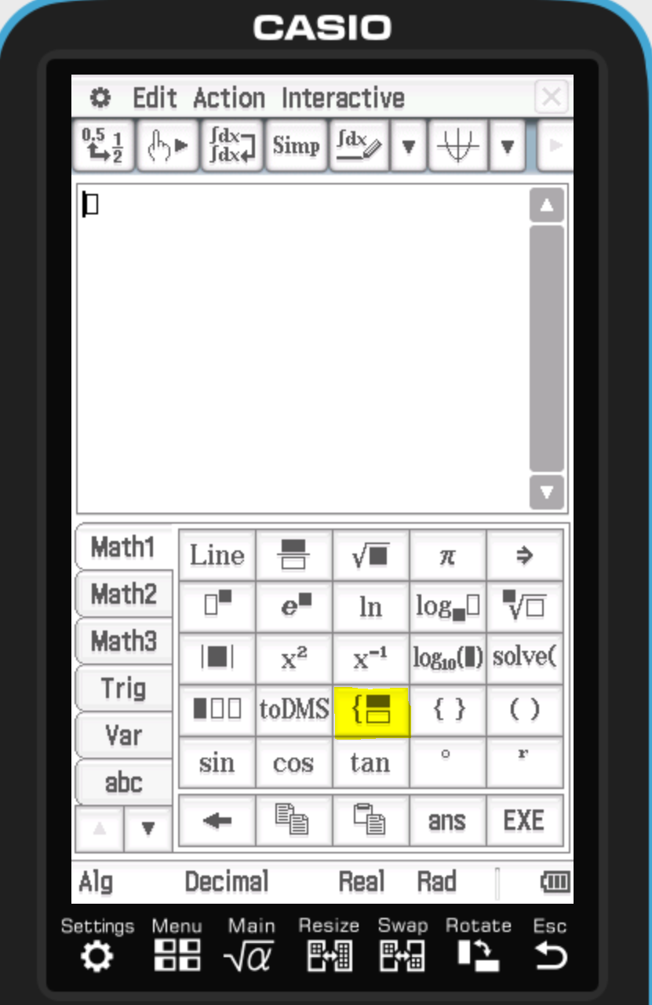
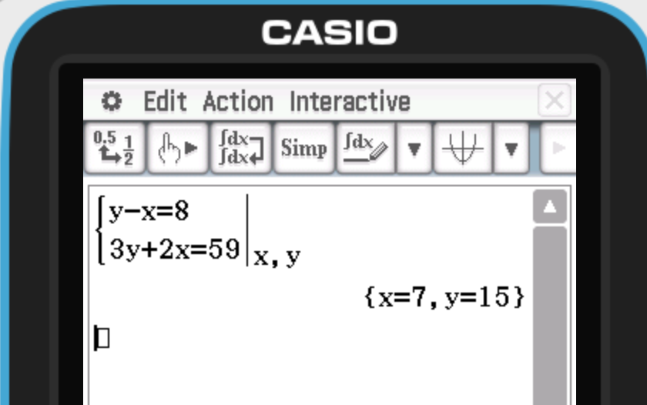
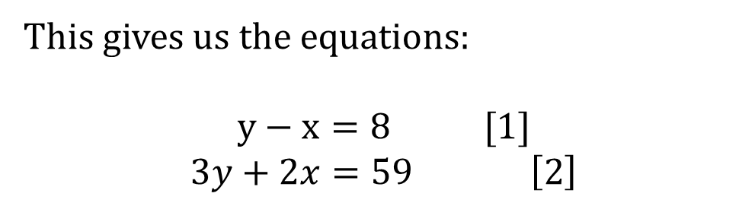
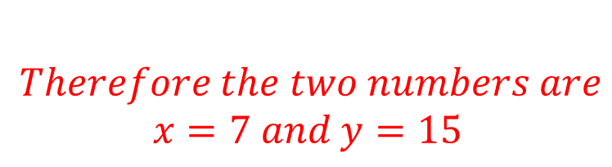
Example 5- Solving word problems
Two numbers have a difference of 8 whilst three times the larger added to twice the smaller totals 59. Find the two numbers
This gives us the equations:
$$y−x=8 [1]$$
$$3y+2x=59 \left[2\right]$$
$Therefore the two numbers are$
$$x=7 and y=15$$

Slide 12
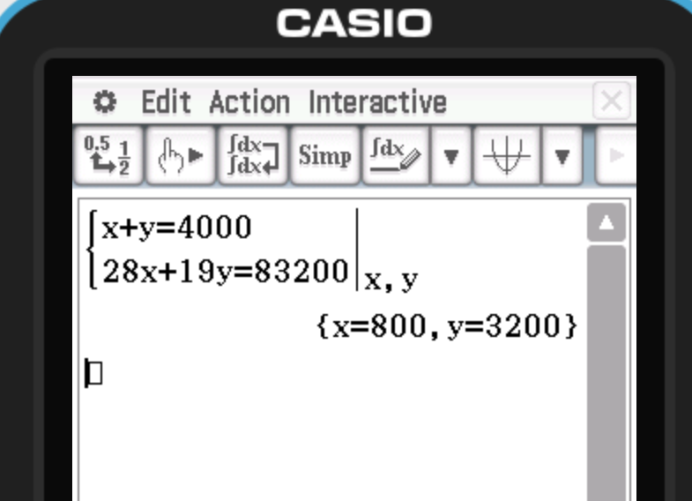
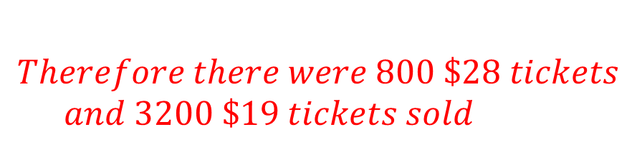
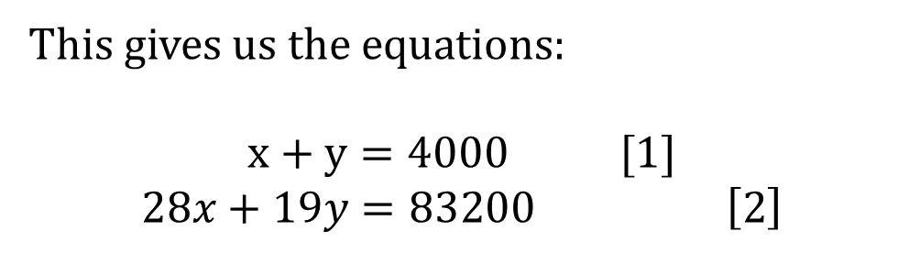
Example 6- Solving word problems
Ex 12A
Every one of the 4000 movie tickets for a music concert at an entertainment centre is sold. Some of the tickets cost $28 each and the remainder cost $19 each. If the total revenue from the sale of the tickets is $83200 find how many of the 4000 tickets cost $28 and how many cost $19.
$Therefore there were 800 \$28 tickets$
$$and 3200 \$19 tickets sold$$
This gives us the equations:
$$x+y=4000 [1]$$
$$28x+19y=83200 \left[2\right]$$

